Slide 1
Sustainable Development Goals

Slide 2




Slide 3
Education and Empowerment
Question
Objective
Explore whether regions with higher education level for women experience
lower fertility rates and increased life expectancy
How does education impact the fertility rates and life expectancy of women

Slide 4
Key Indicators
Fertility rate (births per woman)
Life Expectancy at birth (years)
L
Literacy Rate %-Female (15yrs+)

Slide 5



End to end process

Slide 6
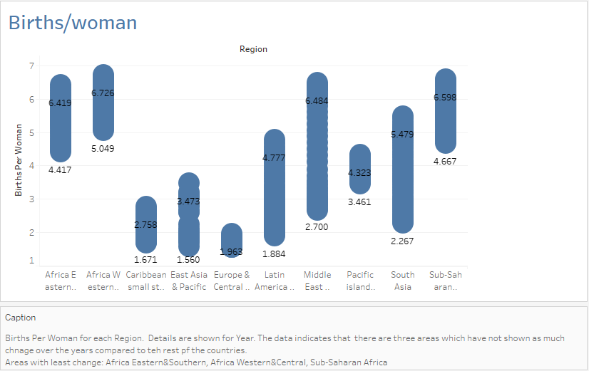

Slide 7
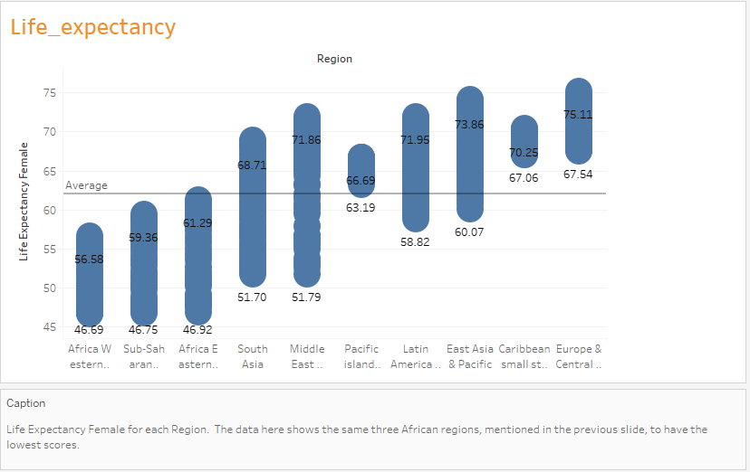

Slide 8
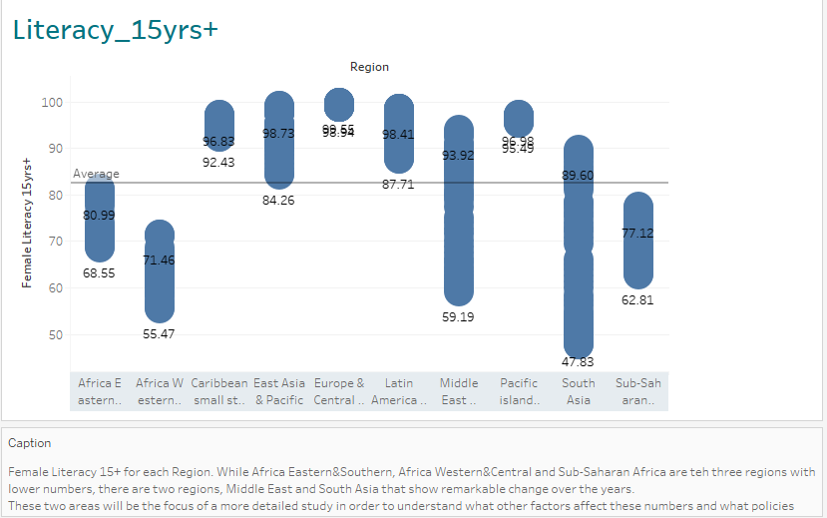

Slide 9
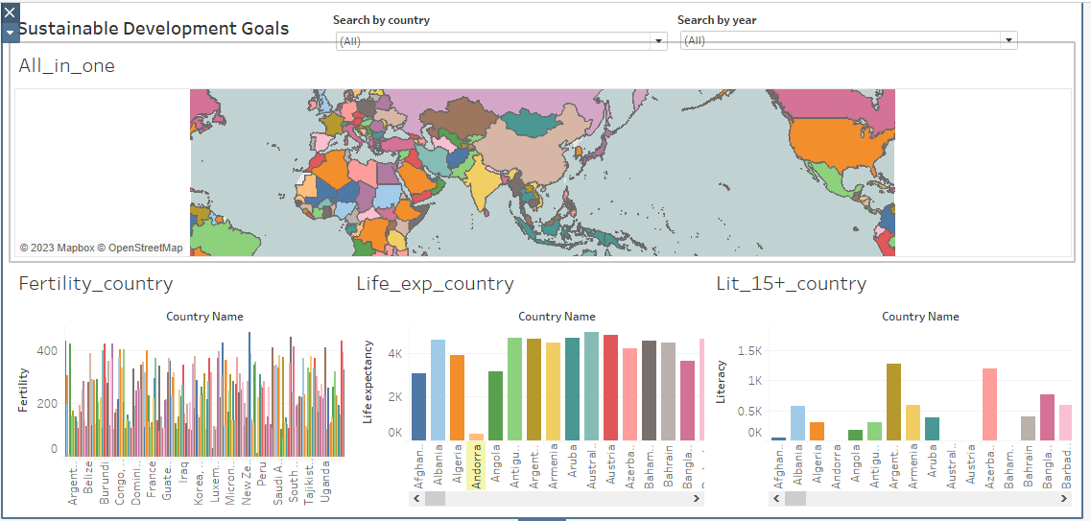

Slide 10



Datasets

